Slide 1

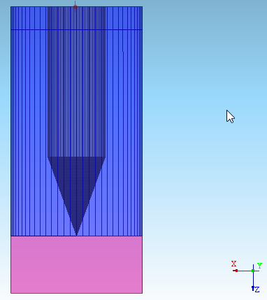
QuickWave simulations of metas probe
Scenario description (modifications for initial model given in pink):
Sample:
- chip size 1mmx1mm – 1.15 x 1.15 mm (determined by coax size)
- 500um thick P doped wafer with resistivity 0.2 ohm.cm
- 500nm silicon nitride epsilon_r=7 on top
-the SiN surface is divided in 4 quadrants, 3 quadrants do not have gold coating, one quadrant has gold coating of 100nm
SMM:
- platinum smm tip with 100nm probe diameter (sphere) – flat in first approach
- probe cone angle 20 degree (cone connects to sphere)
- wire diameter 500 um (cylinder connects to cone)
- free tip length is 2 mm (from tip to top boundary)
Boundary conditions:
- Bottom, Sides: PEC
- port for microwave access 50 ohm ( outer diameter can be computed from 500um wire diameter)

Slide 2
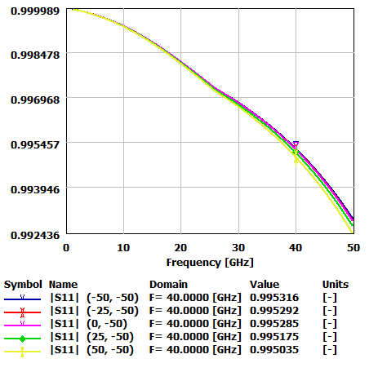
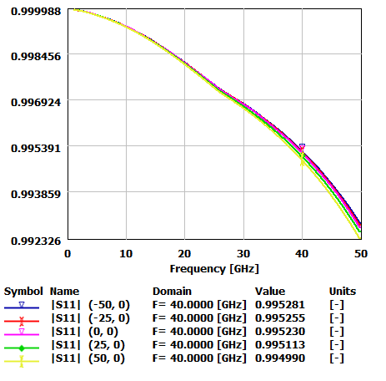
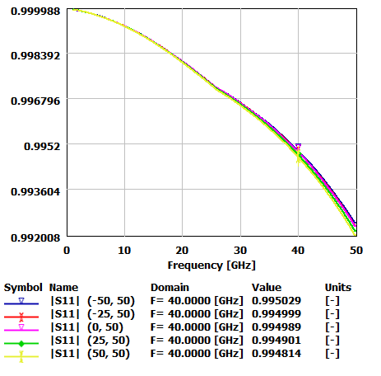
QuickWave simulations of metas probe
Silicon Nitride
SiN
Wafer
Au
Au
Sketch of material sample
Sample scanning area limited with (in um)
Point O (0,0)
Point A (-50, -50)
Chosen probing results
Point B (50, -50)
Point C (50, 50)
Point D (-50, 50)

