Slide 1
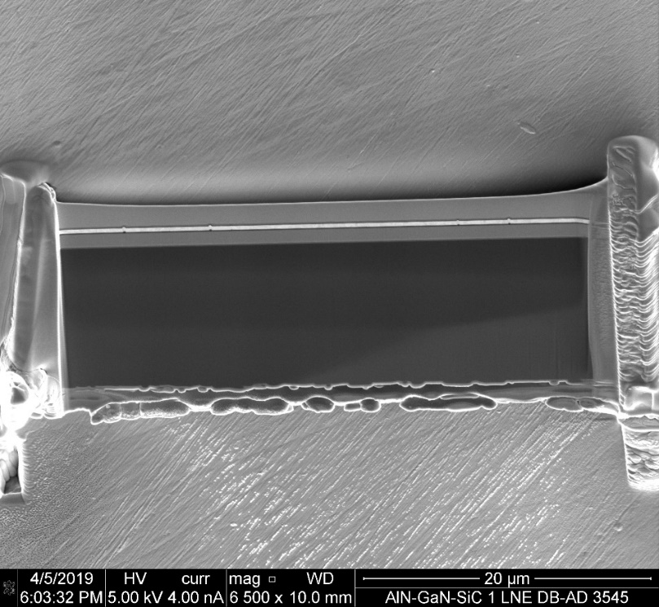
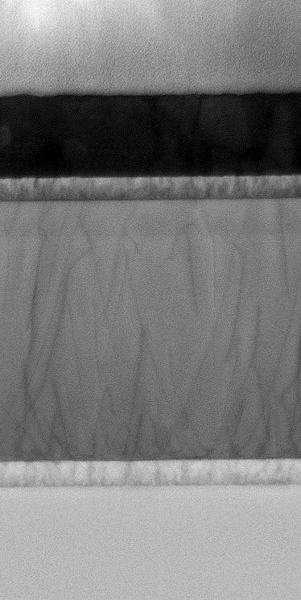
Sample composition
AlN/GaN-on-SiC
Au-coated sample holder
Amorph. deposited Pt (1-2 µm)
Polycrystalline Pt-Au (360 nm)
Ti rich layer (100 nm)
SiN cap (6 nm) / AlN barrier (5 nm)
GaN channel (150 nm)
A 39 x 15 µm²
lamella
AlGaN (990 nm)
AlGaN (110 nm)
SiC substrate
200 nm
Left: A top-view image of a lamellae produced using focus ion beam technique. The sample was glued to a gold coated sample holder. Right: a zoomed image of the region of interest, where layers of different materials locate (framed region in left panel). As shown, the region consist of layers with different electrical properties: metallic (Pt, Au, Ti, with total thickness of about 2 micron), semiconducting AlGaN+GaN (total thickness of about 1.3 micron) and dielectric SiC substrate.

Slide 2
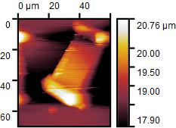
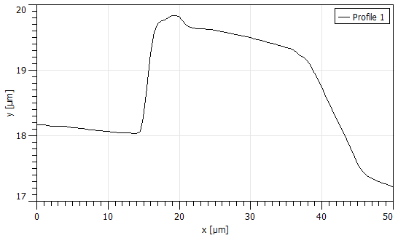
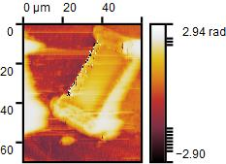
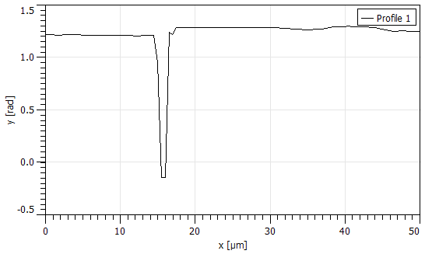
Thin semiconducting lamella
All images and graphs are from the dataset: XYScanNano_60.0x70.0um_120x140px_Al_GaN on SiC1_217.41_200409_010259.gwy
SiC+GaN
GaN?
Top panels: A 2D topography map and a profile extracted from this map along the dashed white line. Bottom panels: A 2D map of the magnitude of S11 and a similarly extracted profile. The thin lamella is visible in both topography and electrical maps. However, it is difficult to determine the position of GaN/AlGaN multilayers from SiC from profies extracted from these maps (right panels). The position of the film edges cannot be determined precisely because of the tip convolution. In turn, it is possible to guess the position of the GaN/AlGaN layers. Moreover, the lack of contrast in the electrical measurement between GaN/AlGaN and SiC is attributed to the small difference in electrical properties of these materials (both is non-conducting and have similar dielectric constants: ε_{GaN}=5.3 ε_{SiC}=6.52 at high frequency [1]).
[1]: Bougrov V, et al., Properties of Advanced semiconductor materials GaN, John Wilye & Sons, Inc. New York, 2001

Slide 3
Thin semiconducting lamella: sample damage
a)
Before
b)
After
c)
SiC
d)
SiC
AlGaN
AlGaN
Au
Pt
a) and b) Scanning electron microscopic (SEM) image taken before and after SMM measurements. Black dashed frames in a) and b) points at the zone of interest, where multilayers stay. However, as shown in b), this region was damaged during the SMM measurements. We expect that the tip, which is in contact with the sample, removed part of the metallic layers deposited during the production of this lamella. c) and d) are SEM images zoomed in the region of interest. The scale bars in a), b), c) and d) are 5 µm, 5 µm, 500 nm and 1 µm respectively.

Slide 4
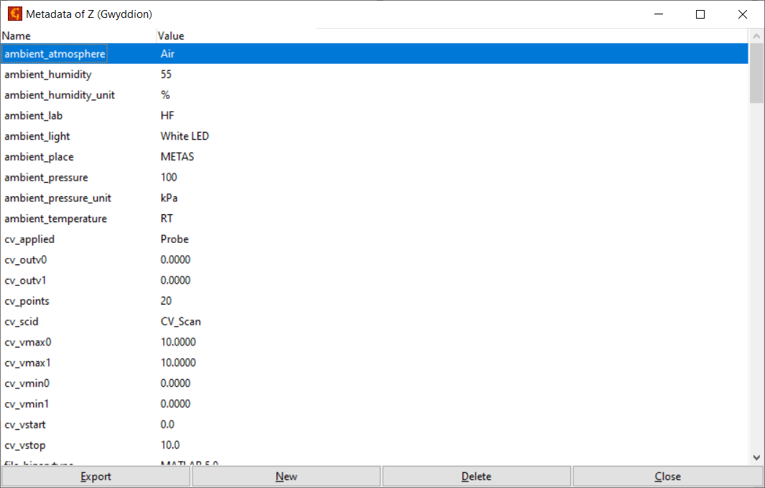
Measurement conditions

Slide 5
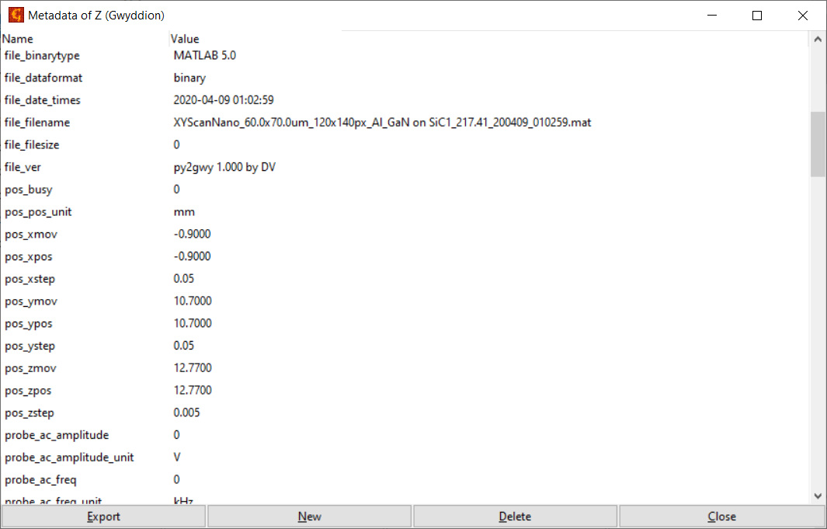
Measurement conditions

Slide 6
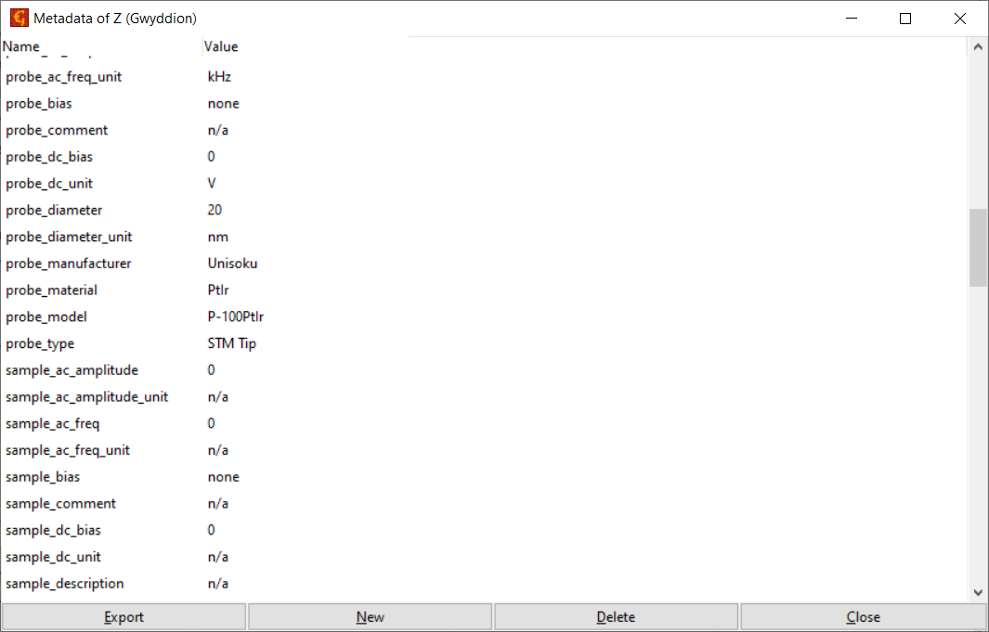
Measurement conditions

Slide 7

Measurement conditions

Slide 8

Measurement conditions

Slide 9
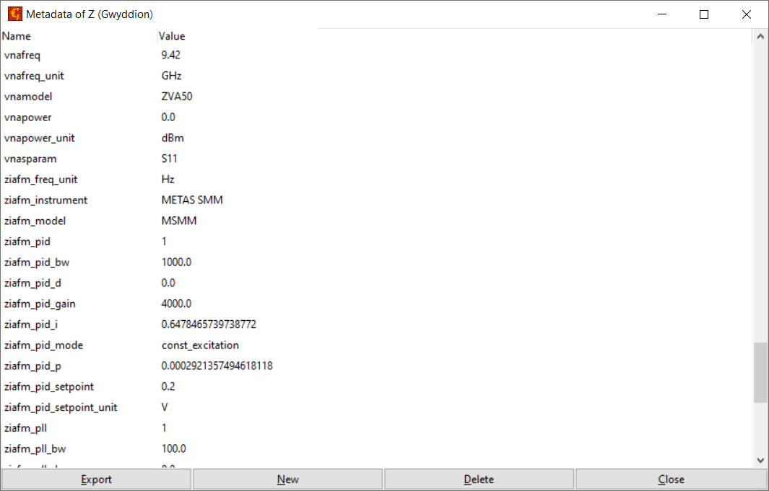
Measurement conditions

Slide 10
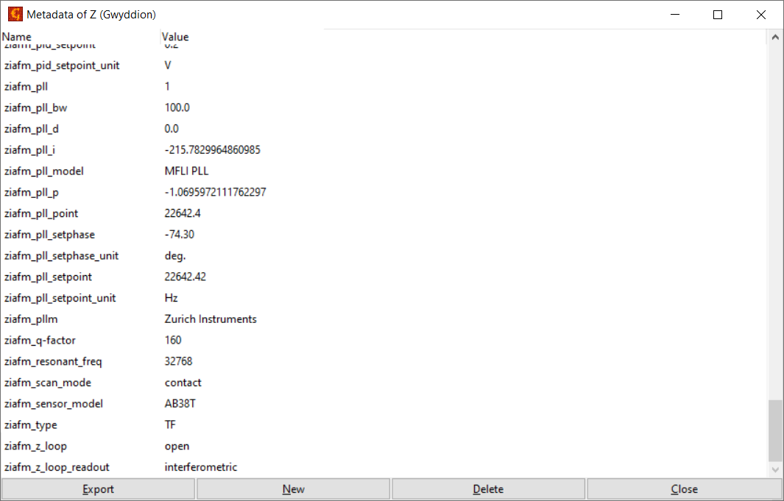
Measurement conditions

