Slide 1
Sample details.
Si wafer: resistivity range: 0.1-0.5 Ohm.cm (boron-doped)
45 nm thick Au, 5 nm thick Ti, 500 nm thickn SiN, 380 micron thick Si
Au
Ti
SiN
Si

Slide 2
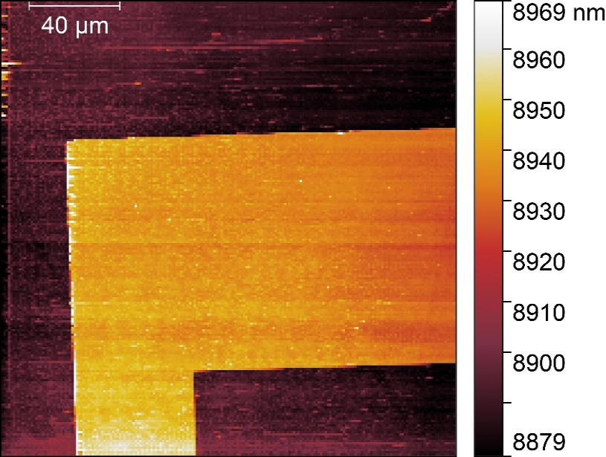
MMAMA test sample
File 1=XYScanNano_200x200um_201x201px_MMAMA test sample_QUTO_190606_210107
File 2=XYScanNano_200x200um_201x201px_MMAMA test sample_QUTO_190606_224642
Topography image (file 1)
Profiles of topology (top panels), magnitude (middel panels) and phase (bottom panels) of S₁₁ extracted from file 1 (left column) and file 2 (right column). Regions where gold films stay (higher Z value) provide stronger signals in both phase and magnitude of S₁₁
Challenges:
AFM artefacts: noise, unoptimized feedback loop
Technical challenges in term of RF physics: contribution coming from external environment. Here, the two measurements were done at similar structures, which stay more than 4 mm away from each other

Slide 3
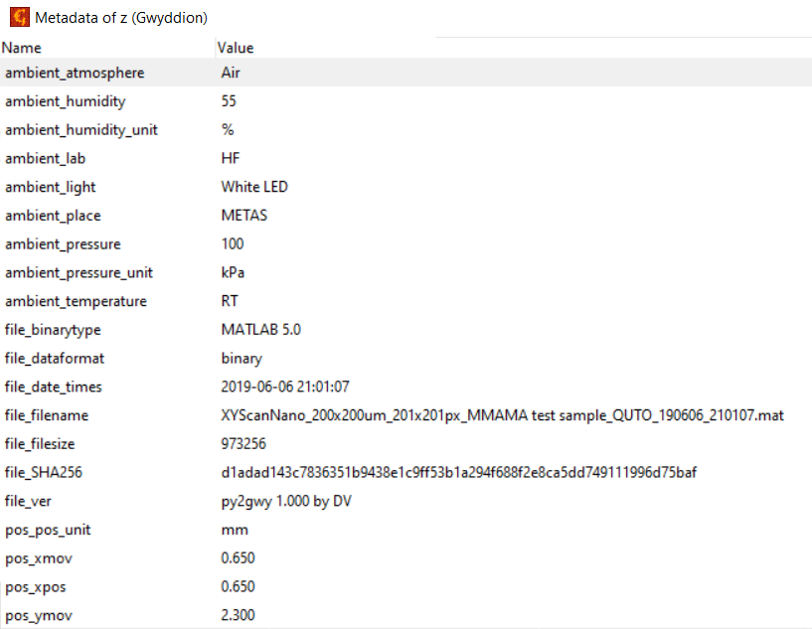
Measurement conditions (file 1)

Slide 4
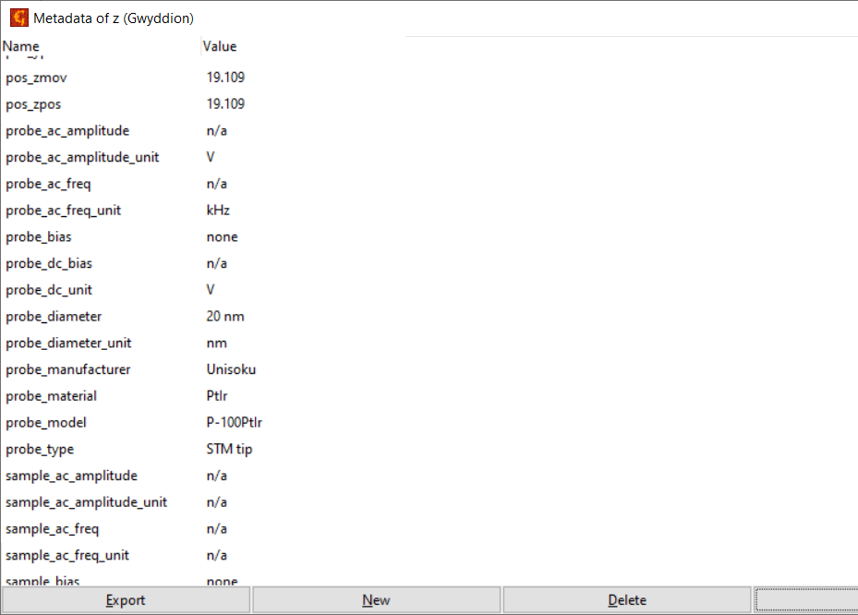
Measurement conditions (file 1)

Slide 5
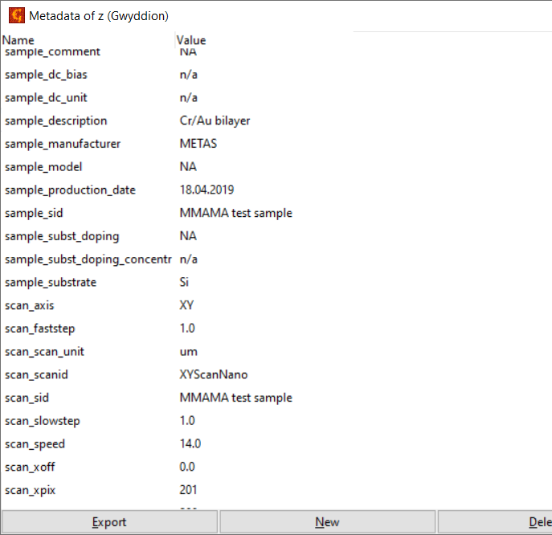
Measurement conditions (file 1)

Slide 6
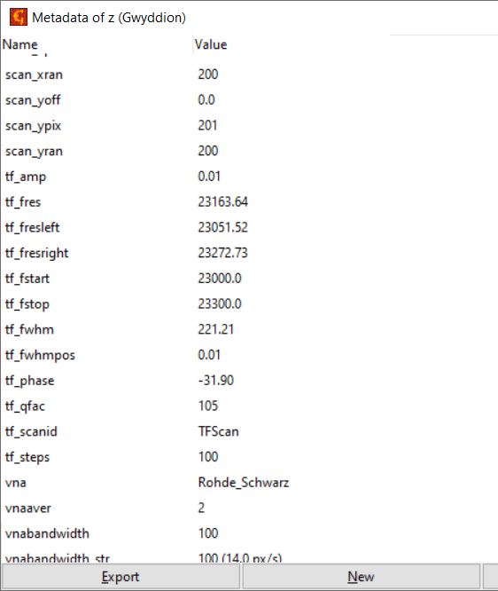
Measurement conditions (file 1)

Slide 7
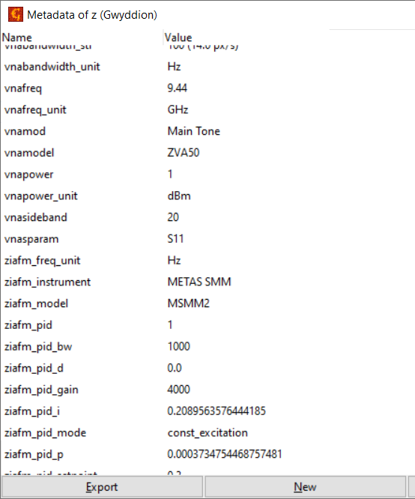
Measurement conditions (file 1)

Slide 8
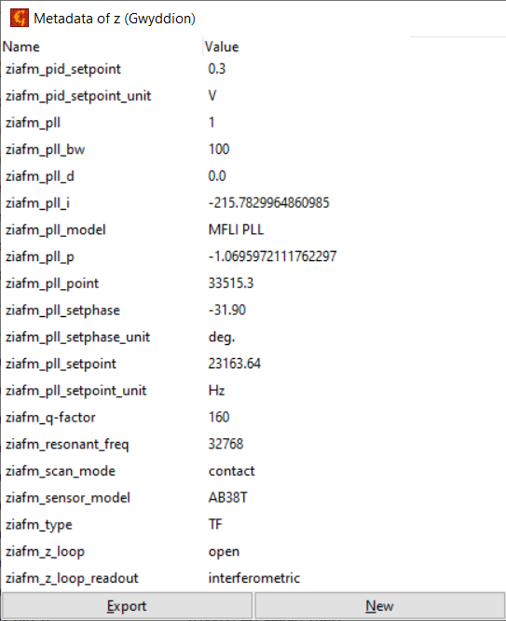
Measurement conditions (file 1)

